Slide 1
INTRODUCTION
Special Methods: init and del
init creates objects
del destroys objects

Slide 2
INTRODUCTION
The typical method-call notation is cumbersome for mathematical classes.
>> polynomial1.add(polynomial2) better or more natural way:
>> polynomial1 + polynomial2
This is called Operator Overloading.

Slide 3
INTRODUCTION
For faster development, reuse, modify, or extend
the built-in attributes, methods & operators of a Class.

Slide 4
INTRODUCTION
Python enables the programmer to overload most operators
to be sensitive to the context in which they are used.
>> print 2 + 3
>> print “Mang” + “Jose”
>> print 2 * 3
>> print “Mang” * 2
#prints “MangMang”

Slide 5
INTRODUCTION
The interpreter takes the appropriate action based
on the manner in which the operator is used.

Slide 6
INTRODUCTION
Some operators are overloaded frequently,
especially operators like + and —.
The job performed by overloaded operators also can be performed by explicit method calls, but operator notation is often clearer.

Slide 7
STRING REPRESENTATION
A Python class can define special method str , to provide an informal (i.e., human-readable) string representation of an object of the class.
str is analogous to Java’s toString() method.

Slide 8
STRING REPRESENTATION
If a client program of the class contains the statement
print objectOfClass
Python calls the object’s str method and outputs the
string returned by that method.

Slide 9
STRING REPRESENTATION
default invocation
>> print halimawSaBanga
main .HalimawSaBanga instance at 0x0204E120
if str is overriden
>> print halimawSaBanga
500-year-old na Halimaw natagpuan sa banga!

Slide 10
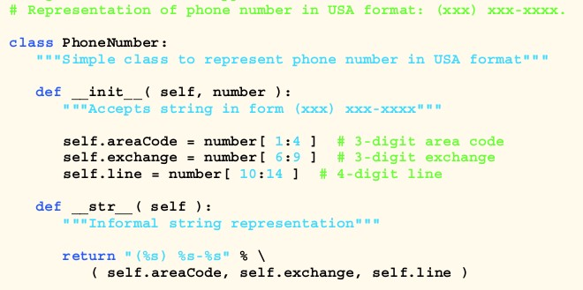
STRING REPRESENTATION

Slide 11
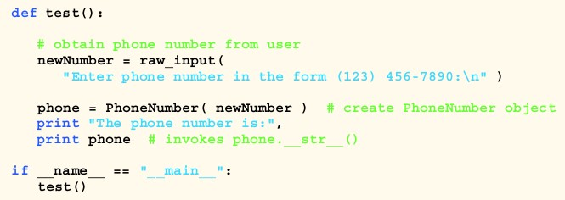



STRING REPRESENTATION

Slide 12
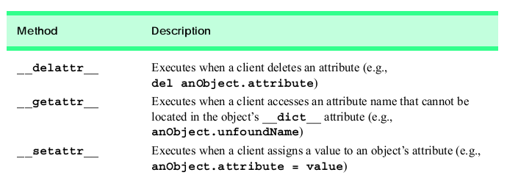
ATTRIBUTE ACCESS

Slide 13
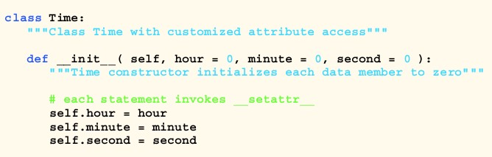
ATTRIBUTE ACCESS

Slide 14
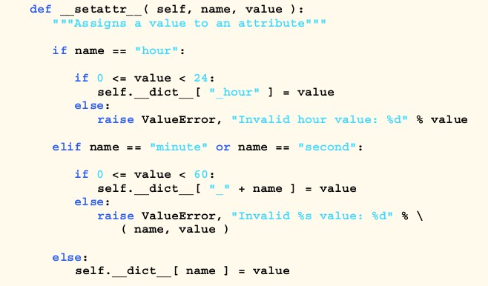
ATTRIBUTE ACCESS

Slide 15
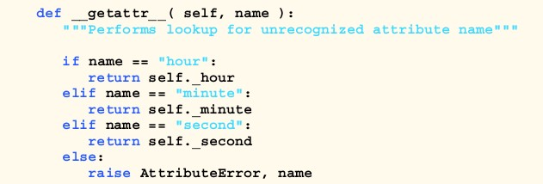
ATTRIBUTE ACCESS

Slide 16
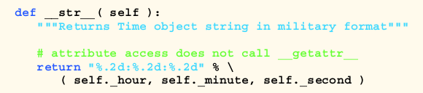
ATTRIBUTE ACCESS

Slide 17
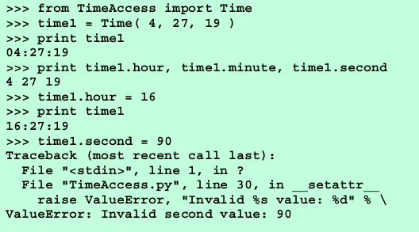


ATTRIBUTE ACCESS

Slide 18

OPERATOR OVERLOADING
Python does not allow new operators to be created, it does
allow most existing operators to be overloaded
when these operators are used with objects of a programmer-defined type, the operators have meaning appropriate to the new types.

Slide 19
OPERATOR OVERLOADING
overloading contributes to the extensibility of Python language

Slide 20
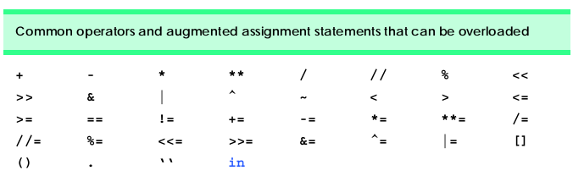
OPERATOR OVERLOADING Restrictions
precedence cannot be changed
arity cannot be changed (i.e., unary to binary)

Slide 21


OPERATOR OVERLOADING Restrictions

Slide 22


OPERATOR OVERLOADING Unary
A unary operator for a class is overloaded as a method that takes only the object reference argument (self )

Slide 23
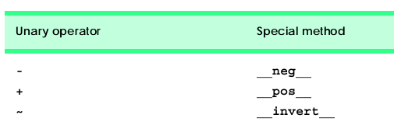
OPERATOR OVERLOADING Unary

Slide 24
OPERATOR OVERLOADING Binary
A binary operator or statement for a class is overloaded as a method with two arguments: self and other.

Slide 25
OPERATOR OVERLOADING Rational
A Rational number is a fraction represented as a numerator (top) and a denominator (bottom).
A rational number can be positive, negative or zero.
Class Rational’s interface includes a default constructor, string representation method, overloaded abs function, equality operators and several mathematical operators.

Slide 26
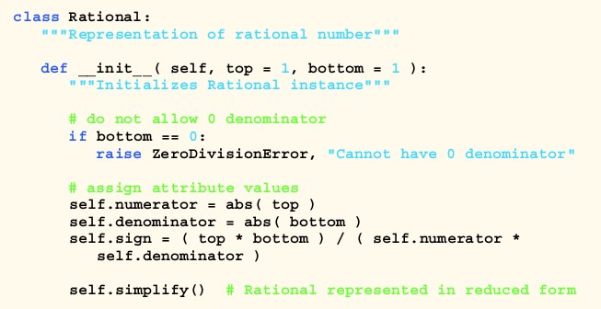
OPERATOR OVERLOADING Rational

Slide 27
OPERATOR OVERLOADING Binary
When overloading binary operator +, if y and z are objects of class Rational, then y + z is treated as if y. add (z) had been written, invoking the add method.

Slide 28
OPERATOR OVERLOADING Binary
Usually, overloaded binary operator methods create and return new objects of their corresponding class.

Slide 29
OPERATOR OVERLOADING Binary
What happens if we evaluate the expression y + z or the statement y += z, and only y is an object of class Rational?
In both cases, z must be coerced (i.e., converted) to an object of class Rational, before the appropriate operator overloading method executes.

Slide 30
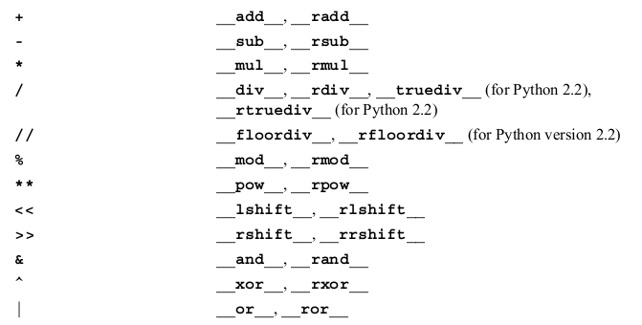
OPERATOR OVERLOADING Binary

Slide 31
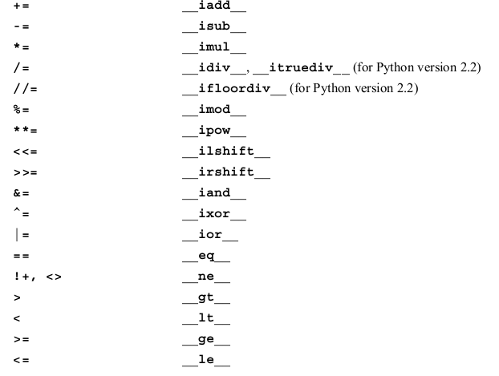
OPERATOR OVERLOADING Binary

Slide 32
OPERATOR OVERLOADING Built-ins
A class also may define special methods that execute when certain built-in functions are called on an object of the class.
For example, we may define special method abs for class Rational, to execute when a program calls abs(rationalObject) to compute the absolute value
of an object of that class.

Slide 33
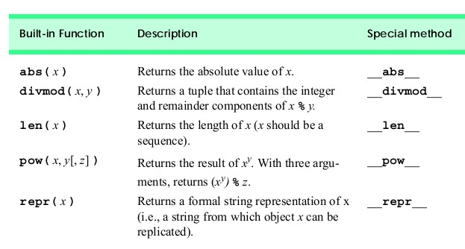
OPERATOR OVERLOADING Built-ins

Slide 34
TYPE CONVERSION
Sometimes all the operations “stay within a type.”
For example, adding (concatenating) a string to a string produces a string. But, it is often necessary to convert or coerce data of one type to data of another type.

Slide 35
TYPE CONVERSION
Programmers can force conversions among built-in types by calling the appropriate Python function, such as int or float.

Slide 36
TYPE CONVERSION
But what about user-defined classes?
The interpreter cannot know how to convert among user-
defined classes and built-in types.

Slide 37
TYPE CONVERSION
The programmer must specify how such conversions are to occur with special methods that override the appropriate Python functions.

Slide 38
TYPE CONVERSION
For example, a class can define special method int that overloads the behavior of the call int( anObject ) to return an integer representation of the object.

Slide 39
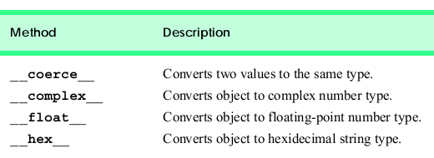
TYPE CONVERSION

Slide 40
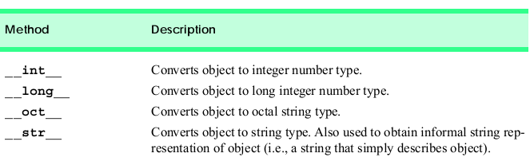
TYPE CONVERSION

Slide 41
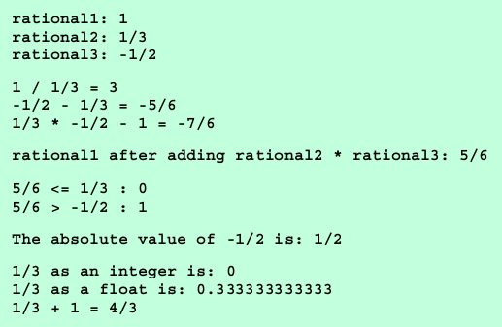
CASE STUDY: RATIONAL CLASS
Sample computations with Rational objects:

Slide 42
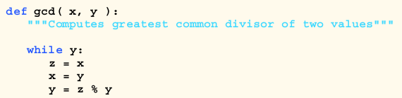

CASE STUDY: RATIONAL CLASS
function gcd() computes the greatest common divisor of two values.
Class Rational uses this function to simplify the rational number.

Slide 43
CASE STUDY: RATIONAL CLASS

Slide 44
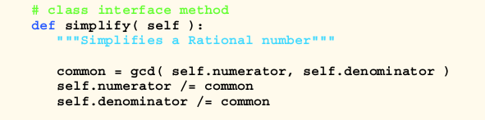
CASE STUDY: RATIONAL CLASS

Slide 45
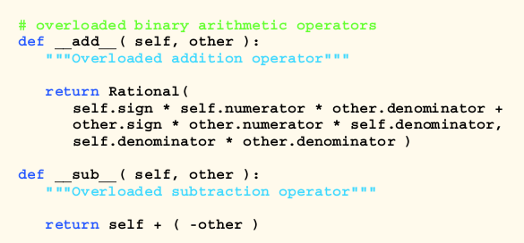
CASE STUDY: RATIONAL CLASS

Slide 46

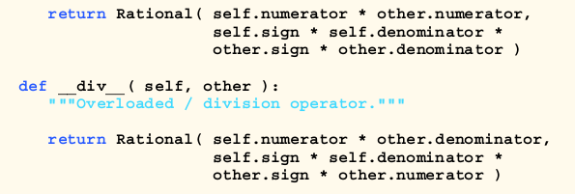
CASE STUDY: RATIONAL CLASS

Slide 47
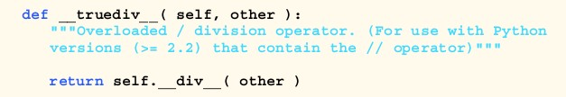
CASE STUDY: RATIONAL CLASS

Slide 48
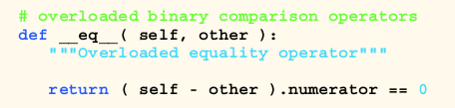

CASE STUDY: RATIONAL CLASS

Slide 49
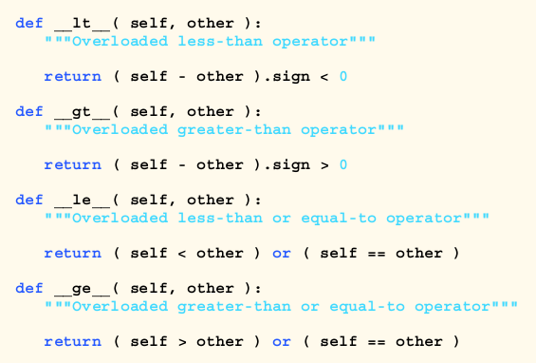
CASE STUDY: RATIONAL CLASS

Slide 50
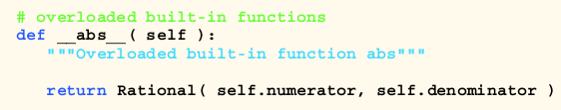
CASE STUDY: RATIONAL CLASS

Slide 51
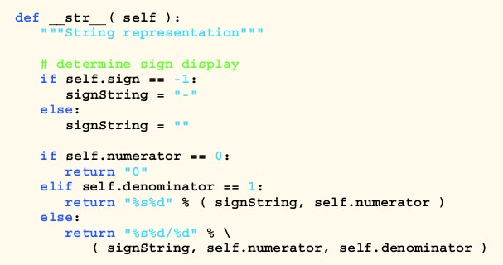
CASE STUDY: RATIONAL CLASS

Slide 52
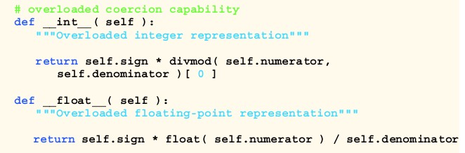
CASE STUDY: RATIONAL CLASS

Slide 53
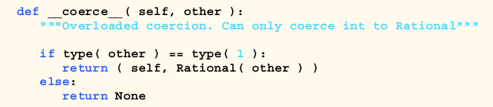
CASE STUDY: RATIONAL CLASS

Slide 54
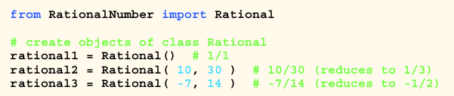



CASE STUDY: RATIONAL CLASS

Slide 55
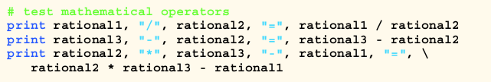

CASE STUDY: RATIONAL CLASS

Slide 56

CASE STUDY: RATIONAL CLASS

Slide 57


CASE STUDY: RATIONAL CLASS

Slide 58

CASE STUDY: RATIONAL CLASS

Slide 59


CASE STUDY: RATIONAL CLASS

Slide 60
END NOTES
Overloading is a powerful concept.
It allows the programmer to reuse/modify existing concepts
and operations.

